Slide 1


IPG Introduction Session
April 6, 2023

Slide 2

Meeting Objectives
IPG Key Responsibilities
Work in Progress
Oracle MVP Scope and Key Milestones
Immediate Next Steps

Slide 3
IPG Key Responsibilities
Project Portfolio Discovery
Work with EA and Project Teams to capture the NextGen projects and key sequence of events being undertaken and ESL dependencies / touch points.
Canonical Model Governance
Define the library of Canonical Data Models that describe the entity relationships, data specification, endpoints and standards to be provided by the ESL
Integration Use Cases
What Integration use cases are being considered and where does it fit in the overall capability model.
Release
Schedule
Manage integration dependencies and development capacity across ESL projects to support the transformation program

Slide 4
Work in Progress
Understanding timelines for ongoing NextGen Initiatives:
Reviewing Merchandise, Store, Supply Chain program plans and scheduling sessions with owners week of 4/10
What documentation is in place for the Legacy landscape, data models, ongoing workstreams
Initial Domain Canonical Data Models for MVP based on Industry Standards (ARTS) to support the release strategy and extend as needed
Integration Strategy Session being scheduled, and progress being made towards establishing the OCI environment and have decisions in place to begin integration design week of 4/28.
Base generic entity relationship models are identified for MVP, working on starting the definition of core Canonical models and JSON representation required for initial MVP scope
Reviewing cross program dependencies for inflight initiatives to identify opportunities for expediting value delivery.
Sessions scheduled with MMS and Retek Legacy application teams to understand requirements for MVP.
Are there other projects in flight using foundation data from legacy that we should align with to demonstrate this opportunity as we get started?

Slide 5
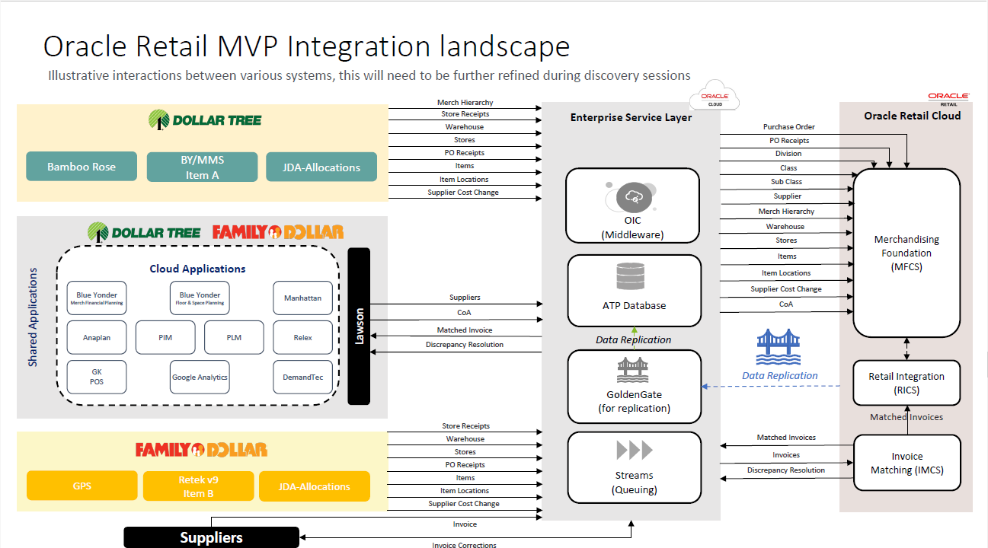

Slide 6
Immediate Next Steps week of 4/10
1) ATS Integration Session 1: Wednesday 4/12 @ 11am, agenda will be
Review PaaS components, answer any questions from OCI foundation workshop
Oracle Application Integration (OIC) explained
Integration strategy (OIC specific)
QA/open forum
2) ATS Integration Session 2: Thursday 4/13 @ 1pm, agenda will be
RICS overview
Integration use cases
Integrations targeted for this phase
Where Talend ETL fits in this implementation (?)
QA/open forum
3) NextGen Program Discovery: Meetings and Attendees TBC (Abhay assisting)
Supply Chain OMS
POS
4) IPG / EA schedule
Agree cadence and status review ongoing (Geoff / Yughandar)

Slide 7

PROJECT WEEKLY STATUS: IPG MARCH 31, 2023
EXECUTIVE SPONSOR: Bobby Aflatooni, Larry Gatta, Rick McNeely PROGRAM LEADER: Abhay Shetty / Bryan Byrd PM/lead: Rajesh Thukral
Period 2 Q1 |  | Period 3 Q1 |  |  |  | Period 4 Q2 |  |  |  | Period 5 Q2 | Period 5 Q2 |  |  |  | Period 6 Q2
03/20 | 03/27 | 4/3 | 04/10 | 04/17 | 04/24 | 05/01 | 05/08 | 05/15 | 05/22 | 5/29 | 06/05 | 06/12 | 06/19 | 06/26 | 07/03 | 07/10
On-track
Risk or delay
Critical issue or delay
Completed
HEADLINES
Engaged with Enterprise Architecture team Participated in project kickoff sessions, oracle foundation session and MVP breakout planning Integration strategy and portfolio governance planning in progress
KEY CHALLENGES (R = Risk, I = Issue, A = Action, D = Decision) |  | OPEN DATE | OWNER | PLAN TO CLOSE | HELP NEEDED
A | Need to set regular cadence with the core IPG team to understand other ongoing initiatives – By 4/14 | 4/6
DELIVERABLES & KEY MILESTONES | DUE
NextGen Discovery Sessions (SC/POS) | 4/14
IPG Kickoff | 4/21
Approved Integration Strategy | 4/28
PLANNED ACTIVITIES FOR NEXT FEW WEEKS | DUE
Integration Portfolio Governance Introduction with Enterprise Architecture team | 4/7
Engage with APP owners to understand priorities, work streams in progress and landscape for NextGen | 4/14
Prepare draft Canonical Models and Release Priority for MVP | 4/14
Prepare MVP impacted Application integration strategy - DRAFT | 4/21
Prepare Integration Strategy document, ready be presented with DT integration team by 4/12 | WIP
Path to Green
KEY ACCOMPLISHMENTS | COMPLETED
Base generic entity relationship models have been identified for MVP | 4/6
SCOPE | RESOURCES
SCHEDULE | BUDGET
Notes:
Geoff

Slide 8
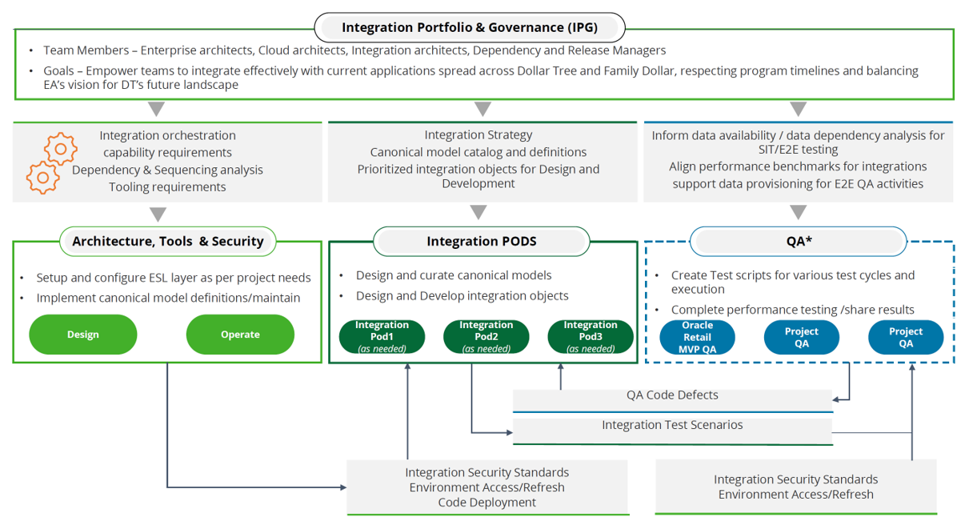
Enterprise Service Layer

Slide 9
